Slide 1

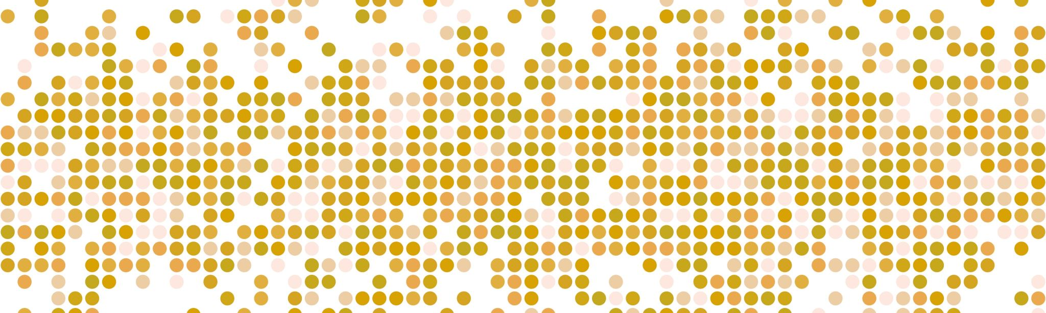
SUPPLY CHAIN DEMAND FORECASTING FOR INVENTORY OPTIMIZATION
Team 4 :
Mohammed Hussain Ilyas
Phani Bhavana Atluri
Yash Jaigude

Slide 2
APPENDIX:
Executive Summary
Business Background
Core Team and Stakeholders
Scope and Objectives
Project Development Timeline
Development Strategy
Development Details
Results
Value and Next Steps
Socialization and Distribution

Slide 3

EXECUTIVE SUMMARY:
Business Opportunity:
Our organization stands to benefit significantly from leveraging predictive analytics to forecast product demand and optimize sales strategies.
By harnessing the power of data-driven insights, we aim to capitalize on market trends, understand customer behavior, and improve decision-making processes.

Slide 4

PROJECT OBJECTIVE
The primary goal of this predictive analytics project is to develop a robust regression model that accurately forecasts product demand by predicting sales thereby increasing inventory performance.
This initiative aims to uncover critical factors influencing sales volume, identify customer preferences, and anticipate market fluctuations.
Ultimately, the objective is to drive enhanced inventory efficiency, business strategies, enhance operational efficiency, and maximize revenue by leveraging data-driven predictive analytics.

Slide 5

Benefits :
Holding Cost
Cash Flow
Avoiding Stockouts
Production Efficiency
Strategic Pricing & Promotions
Order Fulfillment
Procurement/Supplier

Slide 6
BUSINESS BACKGROUND:
Competitive Edge: Predictive analytics provides a competitive advantage by foreseeing market trends and customer preferences, enabling proactive strategies to stay ahead in a competitive landscape.
Resource Optimization: Efficiently allocate resources such as inventory, manpower, and marketing budgets by accurately forecasting sales and demand, reducing costs, and maximizing efficiency.
Enhanced Customer Engagement: Tailoring products, services, and marketing strategies based on predictive insights improves customer satisfaction and fosters loyalty.
Cost Reduction & Revenue Maximization: Accurate sales forecasts facilitate optimal inventory management, reducing excess inventory costs and ensuring products are available when needed, thus maximizing revenue.
Data-Driven Decision Making: Predictive analytics guides strategic decisions, supporting market expansion, product development, and pricing strategies, leading to informed, data-driven decisions.
Operational Efficiency: By predicting future trends, businesses enhance operational efficiency, adapt quickly to market changes, and improve overall performance.

Slide 7

CORE TEAM & STAKEHOLDERS:
Project Team: Our internal team comprises data scientists, analysts, and domain experts specializing in predictive analytics, tasked with developing and implementing the sales forecasting model.
Internal Stakeholders: We will support various internal stakeholders, including the sales department, marketing teams, inventory managers, and senior management, by providing actionable insights derived from the predictive model.
Cross-functional Collaboration: Collaboration with departments like finance, operations, and customer service will facilitate a holistic approach, aligning strategies based on sales predictions.
External Stakeholders: Externally, our outputs will benefit our customers directly through improved service delivery, streamlined product availability, and enhanced customer satisfaction due to better-anticipated demands.
Business Partnerships: Leveraging predictive analytics, we aim to establish stronger partnerships with suppliers by optimizing inventory levels and ensuring timely product availability, thereby enhancing the overall supply chain efficiency.

Slide 8
SCOPE AND OBJECTIVES:
Scope: This project will deliver a robust regression model for sales forecasting, utilizing available transactional, shipping, customer, and product-related data. It will involve data preprocessing, exploratory analysis, feature engineering, and the development of a predictive model to forecast product demand from sales.
Objectives: The project aims to accurately predict sales volumes, identify influential factors impacting sales, and provide actionable insights to optimize inventory management, marketing strategies, and overall business decision-making processes. However, this project will not delve into predictive models for other business metrics beyond sales, such as customer churn or production forecasting.

Slide 9
PROJECT DEVELOPMENT TIMELINE

Slide 10

DEVELOPMENT STRATEGY:
Data-Driven Insights: Supervised learning, particularly regression analysis, is ideal for this sales forecasting project as it leverages historical data to identify patterns and relationships.
Predictive Accuracy: Regression models within supervised learning offer high accuracy in forecasting sales, employing various algorithms to optimize predictions.
Interpretability and Actionability: Supervised learning techniques provide both accurate predictions and interpretability, enabling stakeholders to understand sales influencers and make informed decisions for inventory management and marketing strategies.

Slide 11
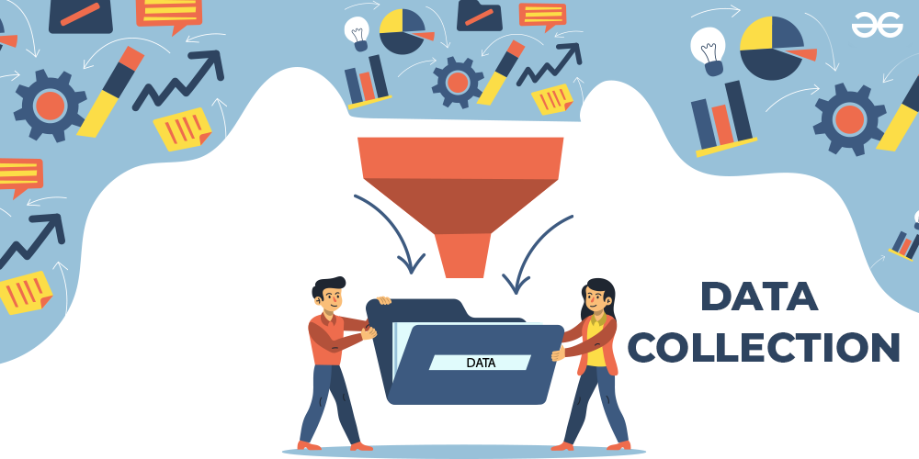
DATA SOURCE:
DEVELOPMENT DETAILS
Origin – Kaggle
Company - DataCo Supply Chain
Raw data - 180519 rows & 53 columns
Period Covered - May 2016 to Jan 2018

Slide 12
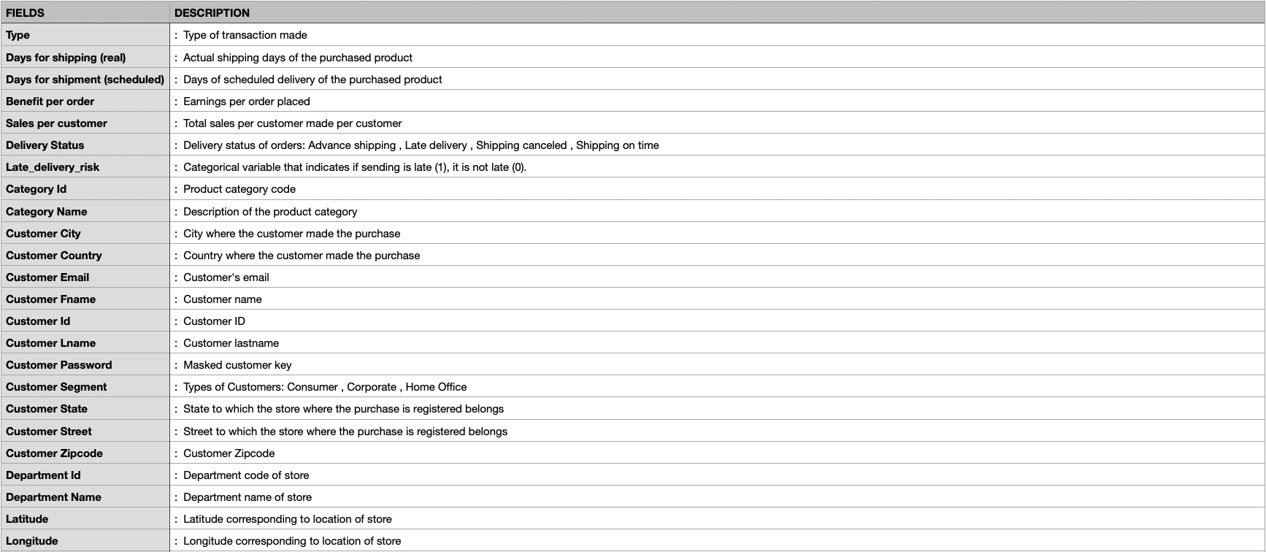
DATA DICTIONARY:
Categorical Data
Demographic Data of Customers
Geographical Data of Customers
Sales Orders
Product Categories
Customer Segment
Purchase Order and Shipping Data

Slide 13
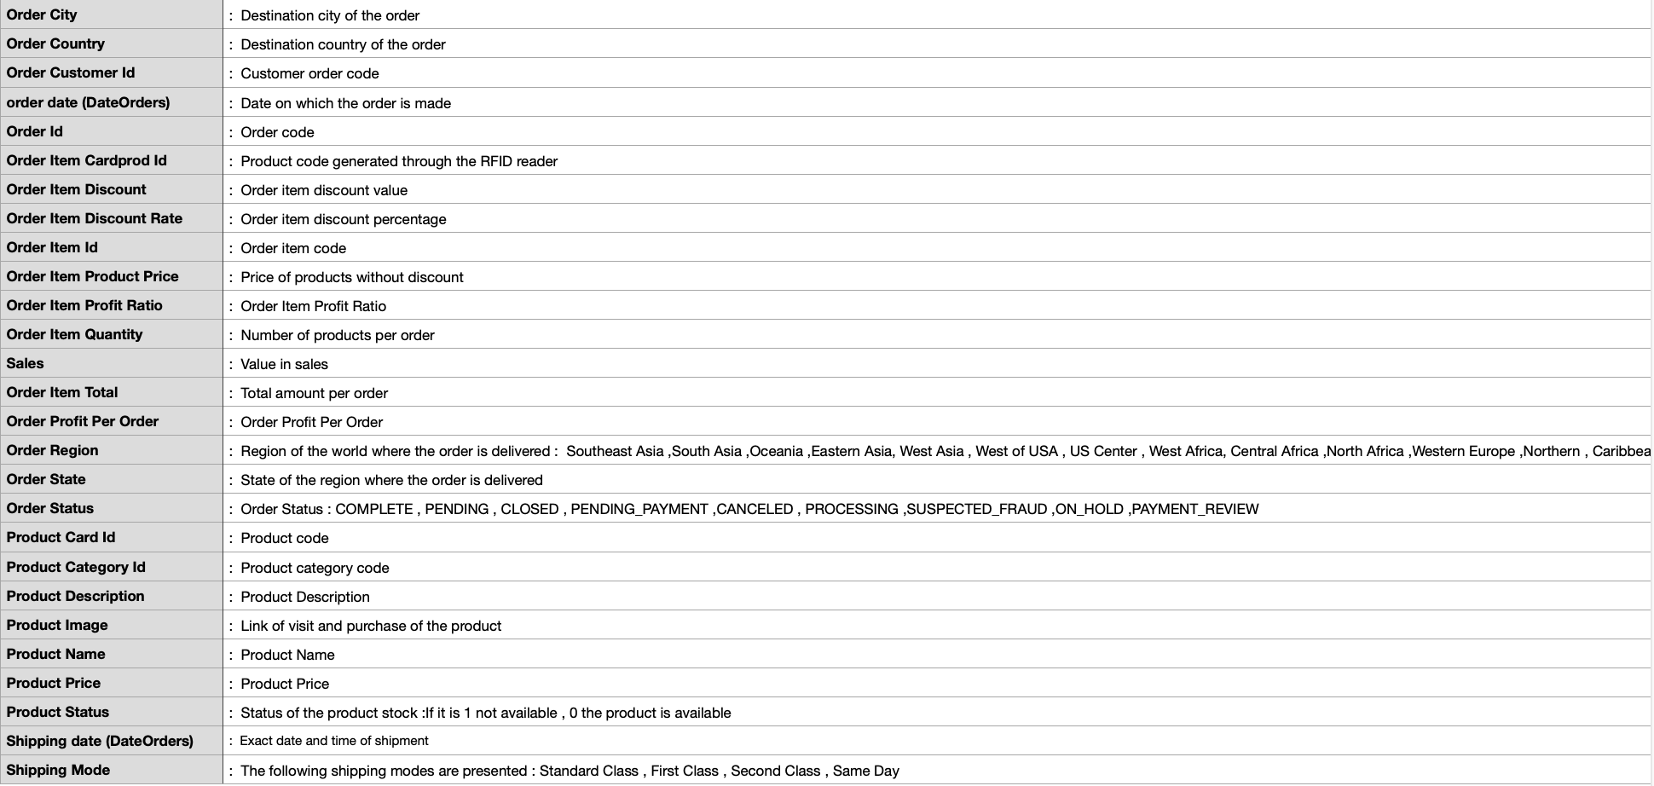

Slide 14
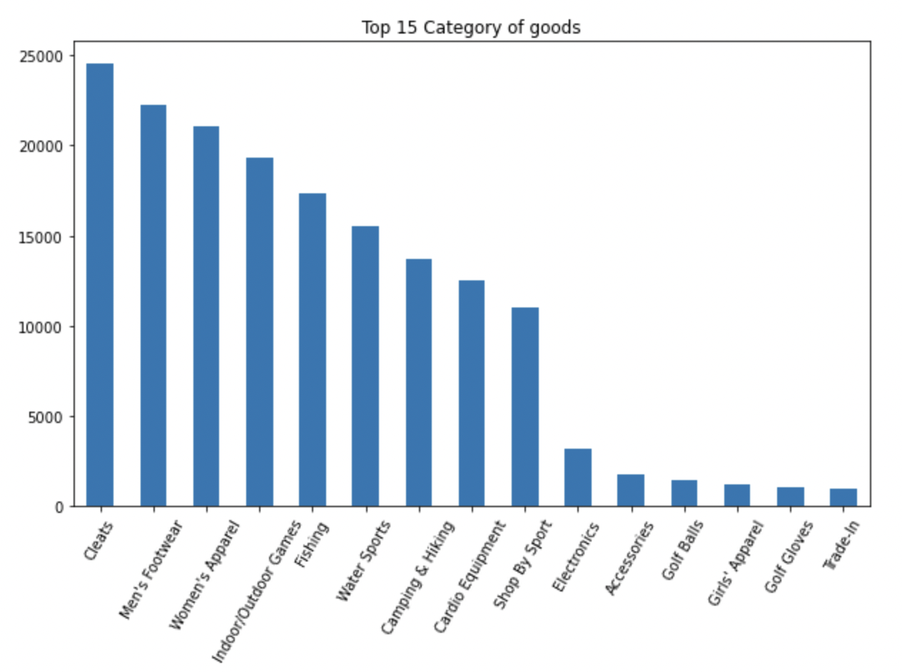
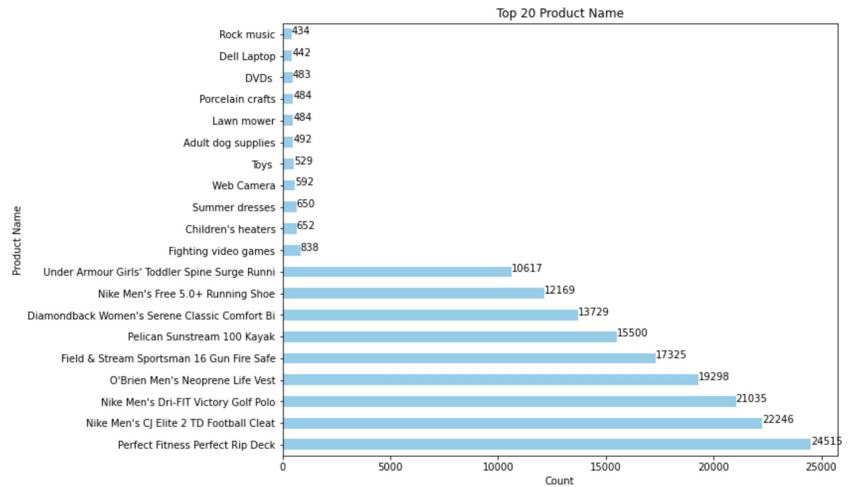
EXPLORATORY DATA ANALYSIS:
Identified and addressed missing or null values within the dataset to ensure data integrity and completeness for analysis
Conducted univariate analysis, examining individual variables' distributions and characteristics to understand their behavior and outliers
From the above plots, the top 20 products and top 15 category of goods which are highly being chosen can be observed

Slide 15
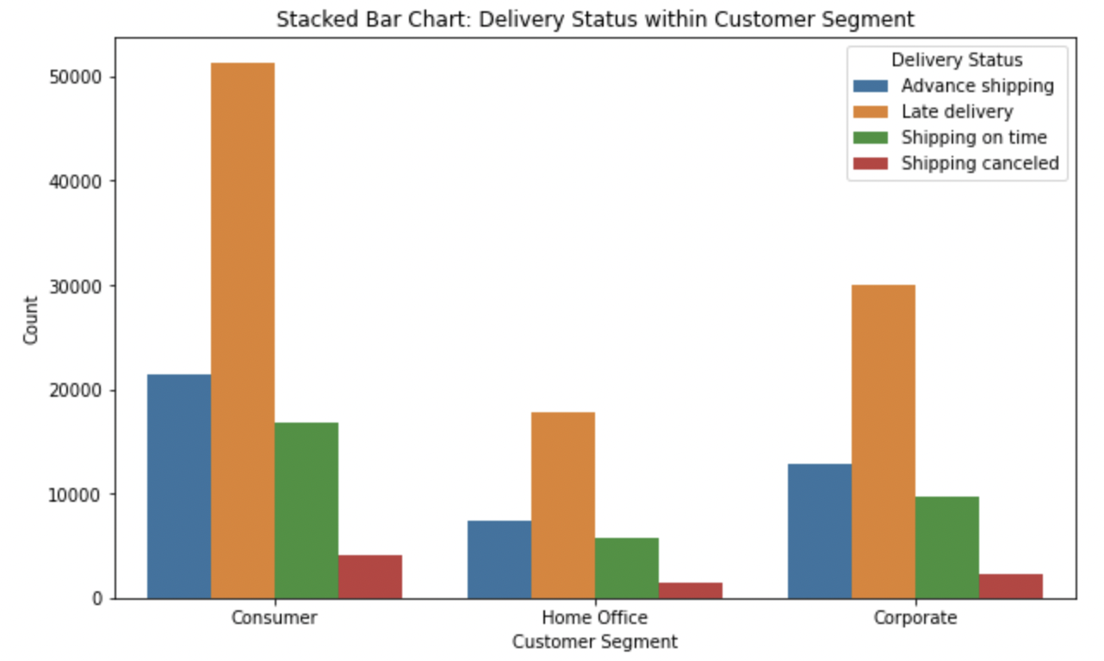
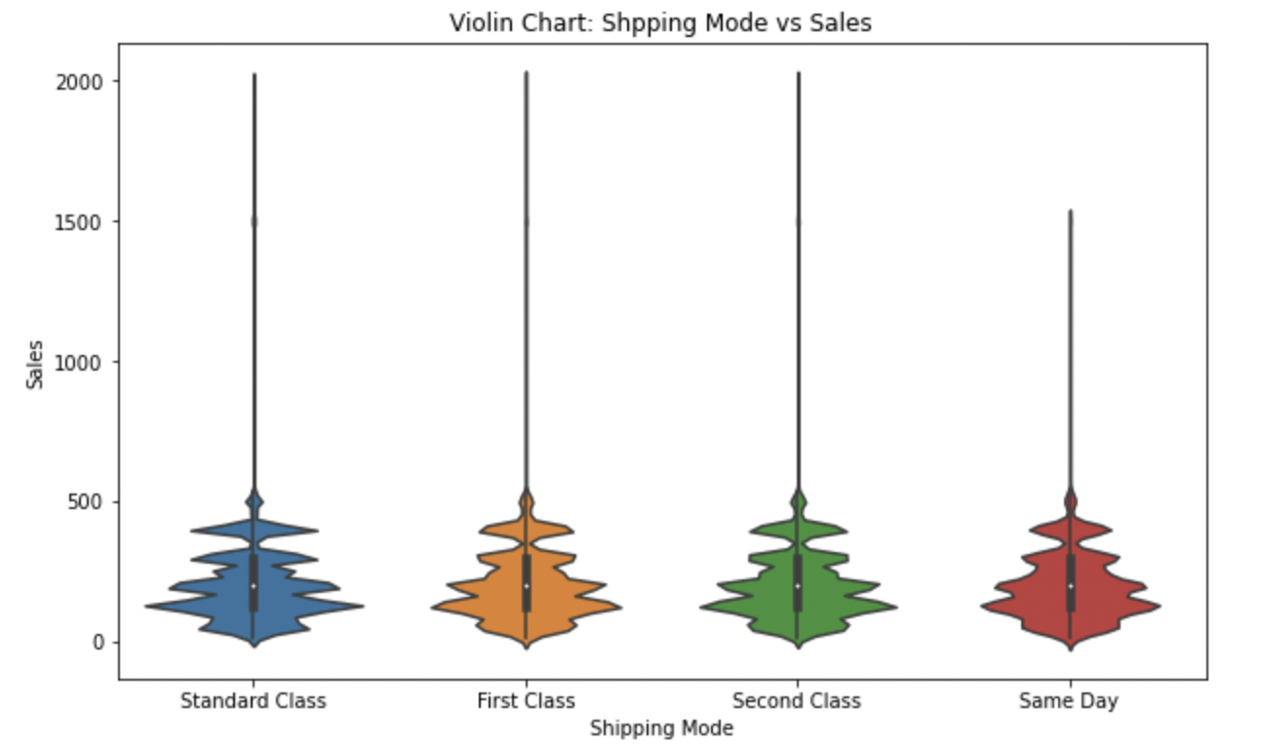
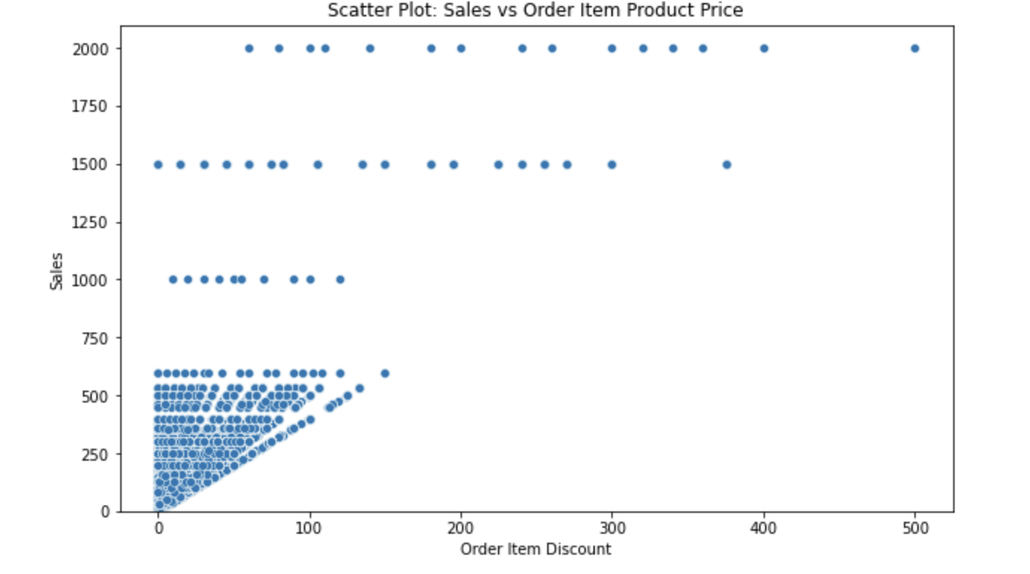
Performed bivariate analysis, exploring relationships between pairs of variables to identify potential correlations or associations
Investigated categorical variables through categorical vs categorical analysis and categorical vs numerical aiming to uncover dependencies or patterns between different features
Also, performed numerical vs numerical analysis to observe the patterns between numerical features
Utilized heatmap visualizations to depict correlation matrices, highlighting the strength and direction of relationships between variables in the dataset

Slide 16
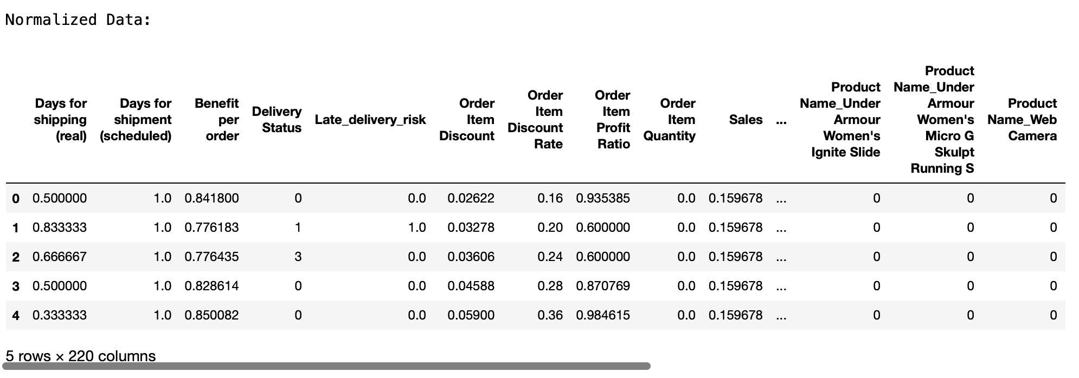
DATA PREPARATION AND FEATURE ENGINEERING:
Data Preparation:
Column Removal: Eliminated unnecessary columns that aren't pertinent for modeling, focusing on features independent of the target variable and dropping highly correlated columns to prevent multicollinearity.
Handling Missing Values: Addressed columns with a significant number of missing values by either imputing missing data or removing columns with excessive missing values for improved model performance.
Feature Engineering:
Label Encoding: Transformed categorical variables into numerical format using label encoding to represent categories as integer values, allowing algorithms to interpret and process categorical data.
One-Hot Encoding: Converted categorical variables into a binary format using one-hot encoding, creating binary columns to represent different categories within a feature.
Standardization: Standardized numerical features to a common scale to ensure uniformity and avoid bias towards variables with larger magnitudes, enabling a fair comparison between different features.

Slide 17

MODEL BUILDING AND PERFORMANCE EVALUATION:
Model Building:
Implemented various regression models including Linear Regression, Ridge Regression, Decision Tree, and Random Forest Regressor to explore diverse modeling approaches.
Employed Linear Regression for establishing linear relationships, Ridge Regression for regularization, and Decision Tree & Random Forest for non-linear modeling, expanding model diversity.
Performance Evaluation:
Utilized regression evaluation metrics like RMSE, R2, and MAE to assess model accuracy and fit.
Conducted a comparative analysis of multiple models, leveraging evaluation metrics to select the best-performing model for predicting the target variable.

Slide 18
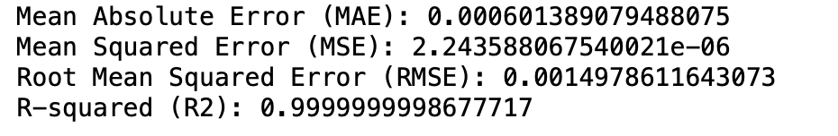
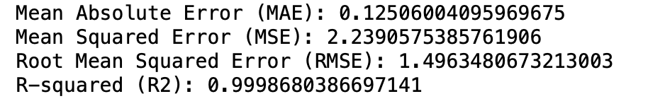
RESULTS:
The Linear Model demonstrates exceptional performance with considerably lower error metrics (MAE, MSE, RMSE) compared to the Decision Tree Model.
The Linear Model achieves near-perfect accuracy with an R-squared value of 1.0, indicating an exact fit to the data, while the Decision Tree Model shows high accuracy (R2 = 0.999) but with slightly larger errors. Also, RMSE score is less for Linear Regression.
Overall, the Linear Model appears to outperform the Decision Tree Model in terms of accuracy and precision in predicting the target variable based on the provided scores.
Linear Regression:
Decision Tree:

Slide 19

INTERPRETATION OF RESULTS:
Make Informed Decisions: Understanding influential factors behind sales forecasts aids in strategic planning, resource allocation, and inventory management.
Optimize Strategies: Insights derived from the model allow stakeholders to tailor marketing campaigns, adjust pricing strategies, and enhance product availability to meet forecasted demand.
Hence, stakeholders should use these findings as guidance rather than absolute predictions, complementing them with market intelligence and domain expertise for nuanced decision-making.

Slide 20
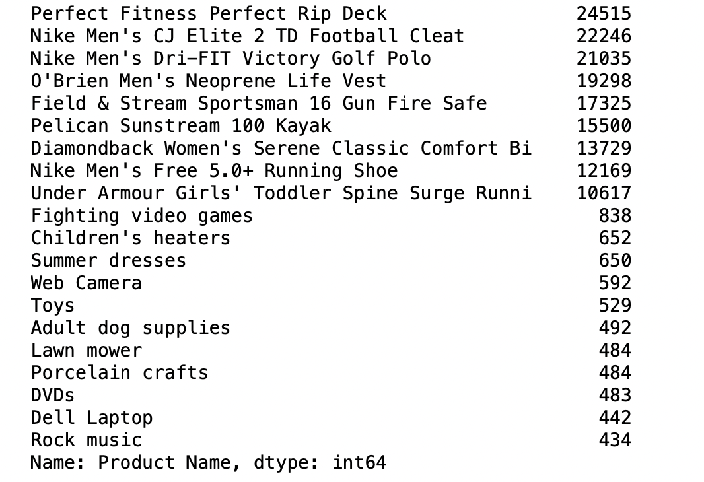
TOP 20 PRODUCTS:

Slide 21
VALUE CREATED AND NEXT STEPS
VALUE CREATED:
Improved Inventory Management: Enhanced demand forecasting enables more accurate inventory planning, reducing stockouts and excess inventory.
Optimized Resources: Efficient inventory management leads to cost savings by minimizing carrying costs and preventing overstock situations.
Enhanced Customer Satisfaction: Accurate demand predictions contribute to better customer service by ensuring product availability and timely deliveries.
Data-Driven Decision Making: The implementation of supervised learning models provides actionable insights for strategic decision-making in supply chain operations.
Financial Impact: Reduced holding costs and improved resource allocation contribute to positive financial outcomes and increased profitability.
NEXT STEPS FOR IMPACT:
Fine-Tuning Models: Continuously refine and optimize the supervised learning models based on performance evaluations and feedback loops.
Incorporate External Factors: Expand the models to include external factors (e.g., market trends, economic indicators)
Real-Time Integration: Implement real-time data integration for immediate adaptation to changing market conditions.
Continuous Monitoring: Set up a system for continuous monitoring of forecasting accuracy and model performance.
Explore Advanced Models: Investigate the applicability of advanced machine learning models, such as ensemble methods or neural networks.

Slide 22

SOCIALIZATION AND DISTRIBUTION:
Regular Reporting Mechanisms:
Scheduled reports and presentations will disseminate sales forecasts and insights to stakeholders for informed decision-making.
This includes scheduled updates and presentations to key departments such as sales, marketing, and inventory management, facilitating informed decision-making.
Interactive Visualization Tools:
User-friendly dashboards will allow stakeholders to explore data, enabling real-time insights and strategy optimization.
These tools will empower stakeholders to delve deeper into the data, gaining actionable insights to optimize strategies and tactics in real-time.

Slide 23
Thank you

